Slide 1
Chapter 4
HCS12/9S12 I/O PORT PROGRAMMING

Slide 2
Objectives
Upon completion of the chapter students will be able to:
List all of the ports of the HCS12
Describe the dual role of HCS12 pins
Code Assembly language to use the ports for input or output
Explain the dual role of HCS12 ports
Code HCS12 instructions for I/O handling
Code I/O bit manipulations programs for the HCS12
Explain the bit addressability of HCS12 ports

Slide 3
I/O Ports and their functions
Number of ports vary with different members of the HCS12 Family
Package type and peripherals supported
80 pin QFP and 112 pin LQFP
Functions in addition to I/O
ADC
Timers
Interrupts
Serial communication

Slide 4
Ports in the MC9S12D Family
Port | Port Name | 80 pin QFP | 112 pin LQFP
 |  | MC9S12Dx 256,128 MC9S12D64, 32 | MC9SDP512, x256, x128, D64
Port A | PORTA | PA7 – PA0 | PA7 – PA0
Port B | PORTB | PB7 – PB0 | PB7 – PB0
Port E | PORTE | PE7 – PE0 | PE7 – PE0
Port H | PTH |  | PH7 – PH0
Port J | PTJ | PJ7 – PJ0 | PJ7,PJ6, PJ1,PJ0
Port K | PORTK |  | PK7, PK5 – PK0
Port M | PTM | PM5 – PM0 | PM7 – PM0
Port P | PTP | PP7, PP5 – PP0 | PP7 – PP0
Port S | PTS | PS3 – PS0 | PS7 – PS0
Port T | PTT | PT7 – PT0 | PT7 – PT0
PAD - A/D converter

Slide 5
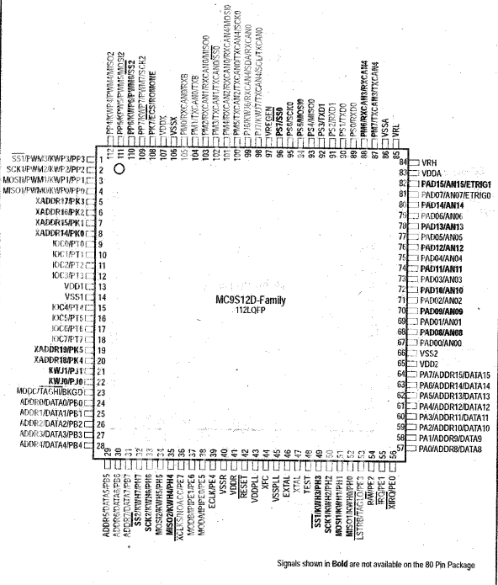

Slide 6
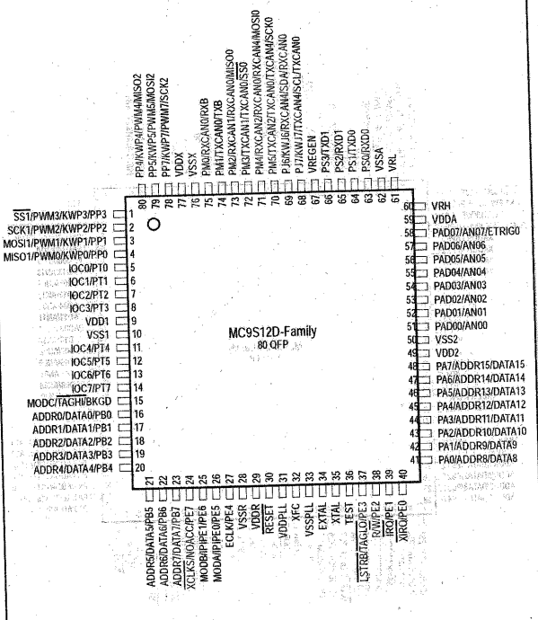

Slide 7
DDR Register and its role in outputting and inputting data
Many of the ports in the 9S12 may be used for either input or output
DDR register contents determine the Port function at a given point in the program
Writing all 1’s to DDRx configures the Port as an output port and we can subsequently write to the Port itsef
Conversely, writing all 0’s to DDRx configures the Port as an input and we may subsequently read from it.
All ports are configured as input after reset

Slide 8
EXAMPLE CODE SEGMENT
; code segment to toggle PORTB
LDAA #$FF ; A IS ALL ONES
STAA DDRB ; CONFIGURES PORT B AS OUTPUT
L1 LDAA #$55 ; A = 55 H
STAA PORTB ; PORT B IS 0101 0101 B
;NOTE THAT COMPLEMENT OF 0101 0101 IS 1010 1010 B OR AA H
JSR DELAY ; ZZZZ
LDAA #$AA ; A = AA H
STAA PORTB ; PORT B IS TOGGLED
JSR DELAY ; ZZZZ
BRA L1

Slide 9
EXAMPLE CODE SEGMENT
; HERE IS ANOTHER WAY TO SKIN THE TOGGLE PORTB CODE
MOVB #$FF,DDRB ; CONFIGURE AS OUTPUT
L1 MOVB #$55,PORTB ; OUTPUT TO PORTB
JSR DELAY ; ZZZZ
MOVB #$AA,PORTB ; OUTPUT COMPLIMENT OF 55 H TO PORTB
JSR DELAY ; ZZZZ
BRA L1 ; TRY IT AGAIN FROM THE TOP

Slide 10
Register Addresses for MC9S12DP512 Ports
Name | Address | Name | Address
PORTA | 0000 | PORTK | 0032
DDRA | 0002 | DDRK | 0033
PORTB | 0001 | PTM | 0250
DDRB | 0003 | DDRM | 0252
PORTE | 0008 | PTP | 0258
DDRE | 0009 | DDRP | 025A
PTH | 0260 | PTS | 0248
DDRH | 0262 | DDRS | 024A
PTJ | 0268 | PTT | 0240
DDRJ | 026A | DDRT | 0242

Slide 11
Code Segment Example
; program to toggle bits of PORTA and PORTB
R1 EQU $1107 ; LOCATION OF R1
R2 EQU $1108 ; LOCATION OF R2
LDS #$8FF ; INITIALYZE STACK POINTER
LDAA #$FF ; A = FF H (ALL RED!)
STAA DDRA ; PORT A IS OUTPUT
STAA DDRB ; PORT B IS OUTPUT
LDAA #$55 ; A = 55 H
L2 STAA PORTA ; PORTA LOADED WITH 55H
STAA PORTB ; PORTB LOADED WITH 55 H
JSR DELAY ; ZZZZ
COMA ; A = AA H
BRA L2 ; DO IT OVER

Slide 12
Code Segment example for delay
; DELAY SUBROUTINE
PSHA ; PUSH VALUE OF A ONTO STACK FOR NOW
LDAA #200 ; A = 200 D
STAA R1 ; VALUE OF ADDRESS 1107 = 200 D
D1 LDAA #250 ; A = 250 D
STAA R2 ; VALUE OF ADDRESS 1108 = 250 D
D2 NOP
NOP
NOP ; 3 CLOCK CYCLES WASTED
DEC R2 ; R2 = R2 – 1
BNE R2 ; INNER LOOP UNTIL R2 = 0
DEC R1 ; OUTER LOOP UNTIL R1 = 0
PULA ; RETRIEVE VALUE OF A FROM STACK
RTS ; RETURN TO CALLING PROGRAM

Slide 13
Code Segment Example
; PROGRAM SEGMENT TO GET A BYTE OF DATA FROM PTH AND SEND IT TO PORTB
LDAA #%11111111 ; A IS ALL ONES
STAA DDRB ; PORT B IS OUTPUT
LDAA #%00000000 ; A IS ALL ZEROS
STAA DDRH ; PTH IS READ
L2 LDAA PTH ; GET VALUE FROM PTH
ADDA #5 ; ADD 5 D TO A
STAA PORTB ; STORE RESULT
BRA L2 ; INFINITE LOOP
; WILL PORTB OVERFLOW?

Slide 14
PREVIOUS CODE SEGMENT USING MOVB
; PROGRAM TO READ PTH, OPERATE ON IT, THEN STORE RESULT IN PORTB
MOVB #$FF,DDRB ;PORT B IS OUTPUT
MOVB #00,DDRH ;PORT H IS INPUT
L2 LDAA PTH ; READ FROM PORT H
ADDA #5 ; OPERATE ON IT
STAA PORTB ; RESULT IN PORTB
BRA L2 ; INFINITE LOOP

Slide 15
Dual Role of Ports A and B
In expanded mode the HCS12 uses Port A and Port B for address/data multiplexing allowing connection to external RAM and ROM
Bit | Funtion | Bit | Function
PA0 | ADD8/DATA8 | PB0 | ADD0/DATA0
PA1 | ADD9/DATA9 | PB1 | ADD1/DATA1
PA2 | ADD10/DATA10 | PB2 | ADD2/DATA2
PA3 | ADD11/DATA11 | PB3 | ADD3/DATA3
PA4 | ADD12/DATA12 | PB4 | ADD4/DATA4
PA5 | ADD13/DATA13 | PB5 | ADD5/DATA5
PA6 | ADD14/DATA14 | PB6 | ADD6/DATA6
PA7 | ADD15/DATA15 | PB7 | ADD7/DATA7

Slide 16
ERRATA
Port E, and Ports H thru T also have alternative functions and uses in expanded mode.
This may be covered in future chapters
Analog to digital converter Pins
Depending on the package either 1 or 2, 8 channel ADC’s are available, (122 pin LQFP 2 are available)
We can use the ADC pins for I/O if not used by ADC
Can’t contain your excitement? Check out Chapter 13

